Slide 1
Dnlf kursnr: 30361
(28/9-2016 10:15-11:00)
www.medviz.uib.no
Bildebaserte biomarkører
- hvordan finne de “riktige” målene i nye radiologiske metoder?
Prof. dr.med Arvid Lundervold
Laboratorium for nevroinformatikk og bildeanalyse & Molecular Imaging Center
Institutt for Biomedisin, Universitetet i Bergen
Radiologisk avdeling, Haukeland universitetssykehus
MedViz
arvid.lundervold@gmail.com

Slide 2
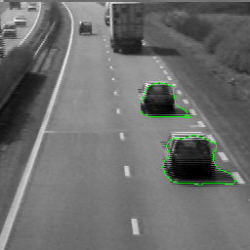
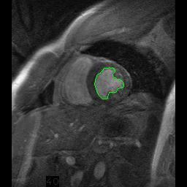
Bildebasert objekt-følging
generiske metoder og tverrfaglighet
Veitrafikk (” bilmarkør ”)
Hjertesyklus (” biomarkør ”)
Active Contours and their applications – Julien Jomier

Slide 3
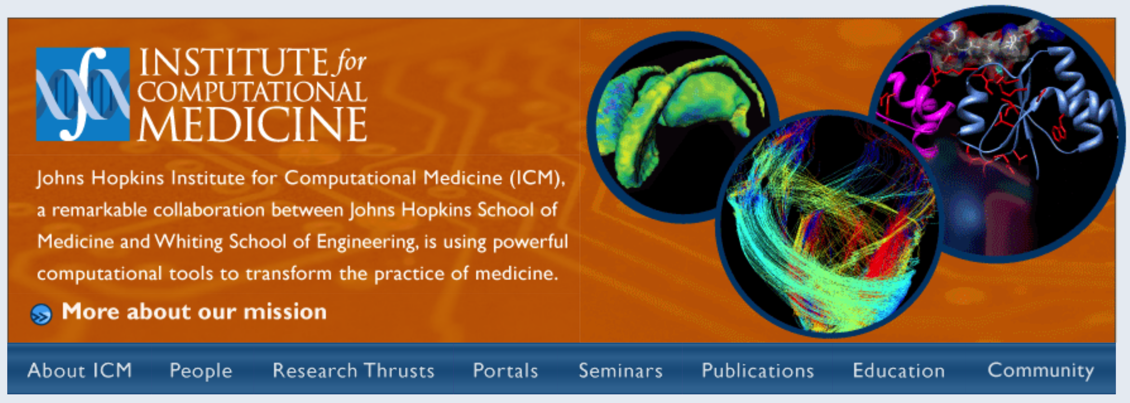
It will soon be common for clinical research studies to:
Collect genetic, transcriptional, proteomic, imaging and clinical data from every patient in large, carefully selected cohorts sharing a specific disease diagnosis.
Johns Hopkins University
The challenge of the coming decade will be
- how best to use these multi-scale biomedical data
- to gain a quantitative understanding of disease mechanisms
- across hierarchical levels of biological organization
- to identify biological markers which correlate with different disease states
- and inter-individual differences in disease risk
Discover more effective therapeutics targeted to the individual
http://www.icm.jhu.edu

Slide 4
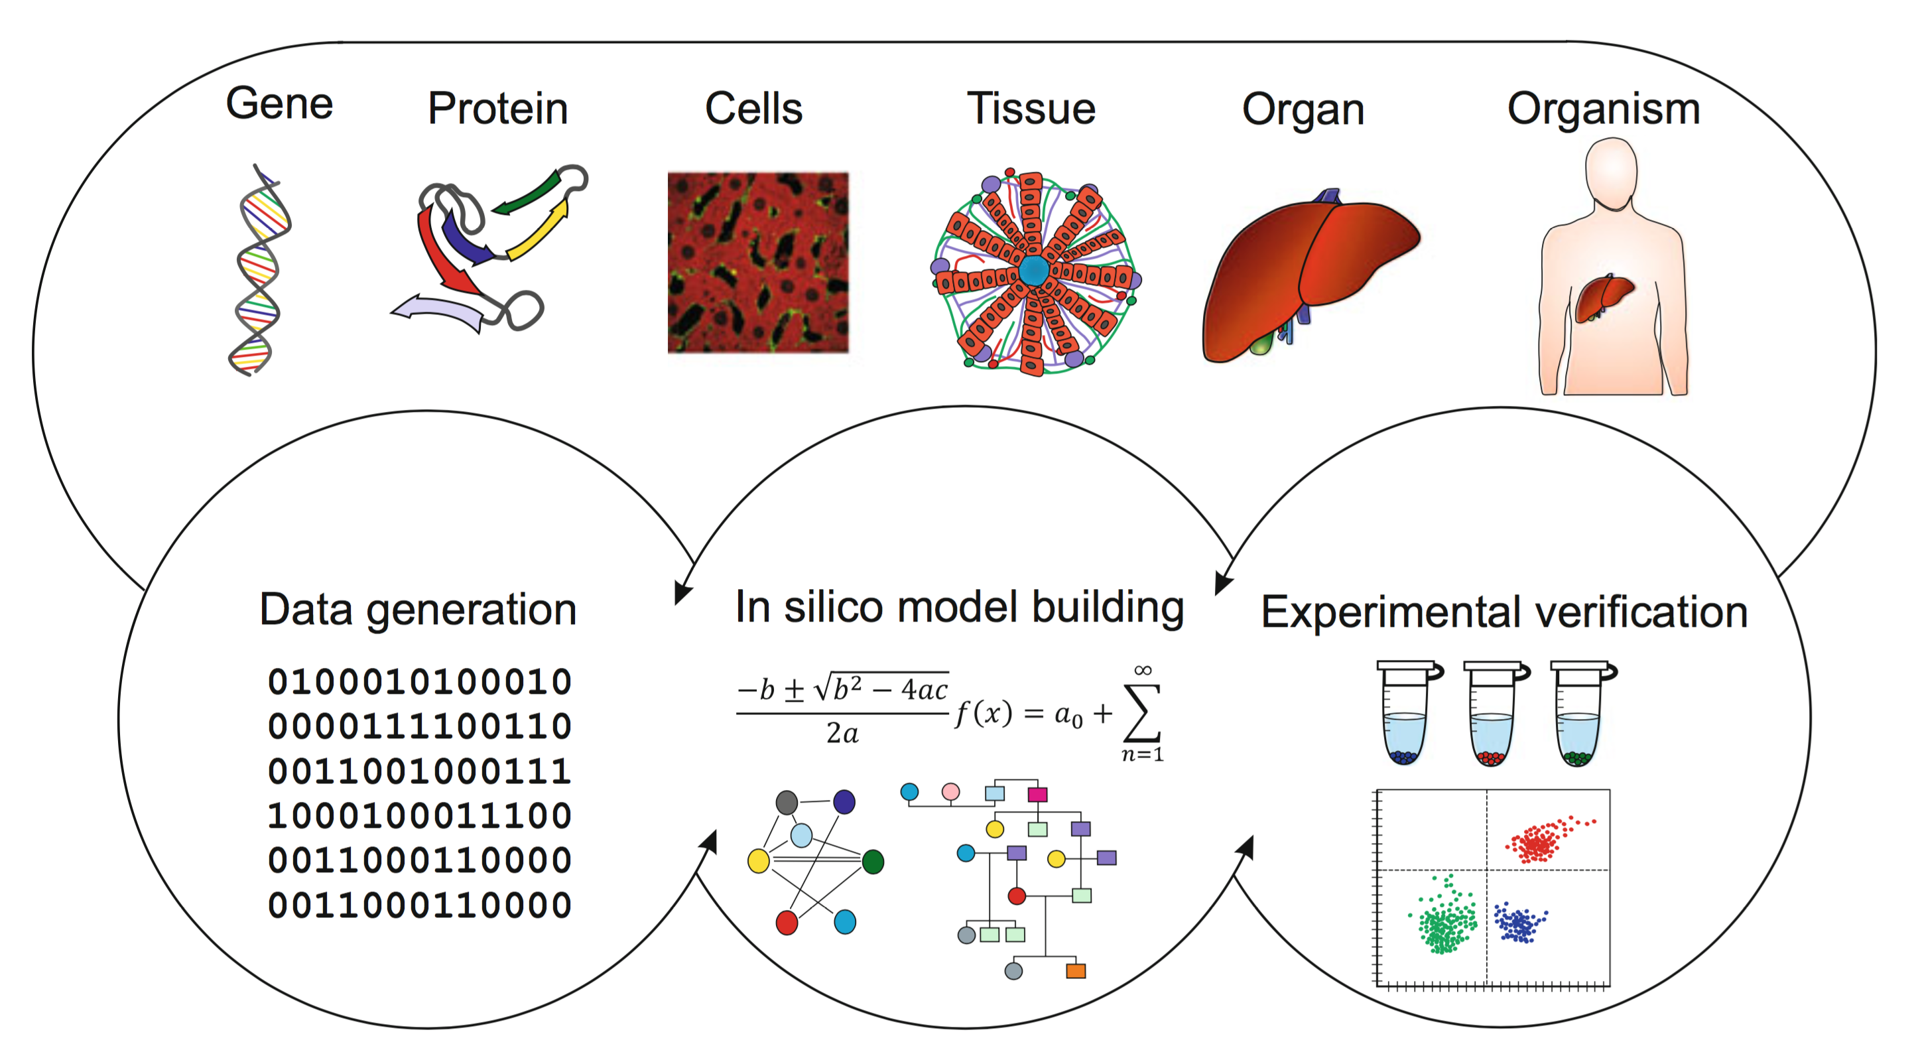
Computational biology Systems biology
Computational medicine Systems medicine
~
“ Beregningsorientert medisin “
Ulf Schmitz, Olaf Wolkenhauer (eds) Systems Medicine, Springer, 2016

Slide 5

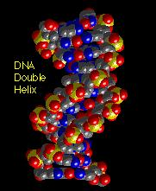
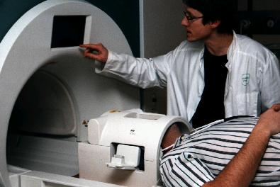
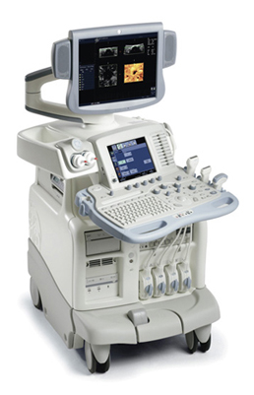
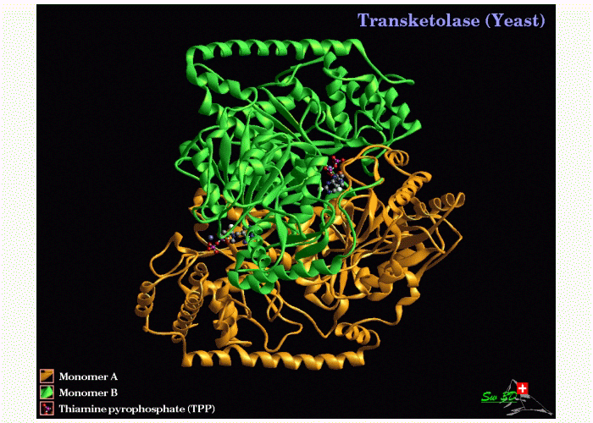
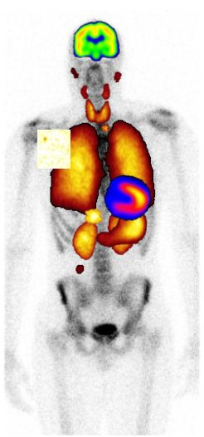
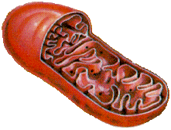
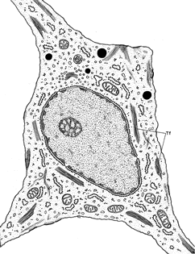
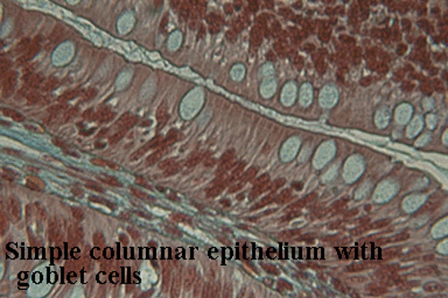
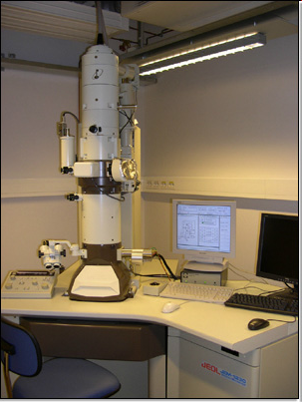
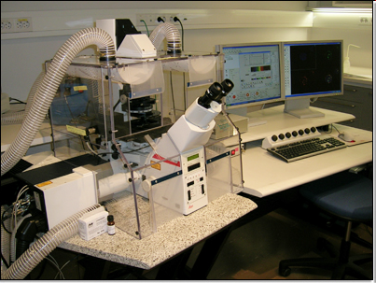
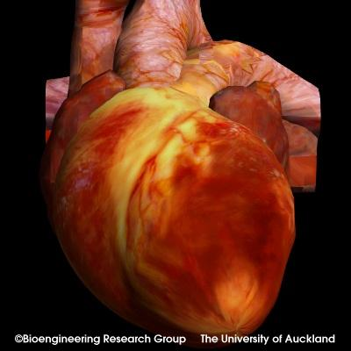
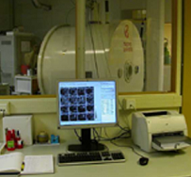

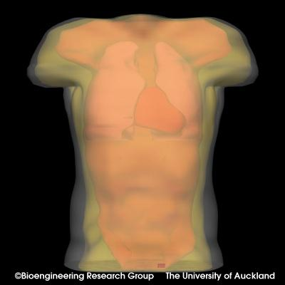
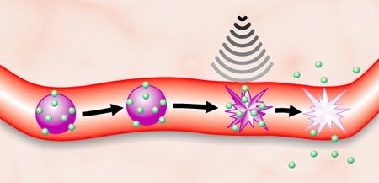
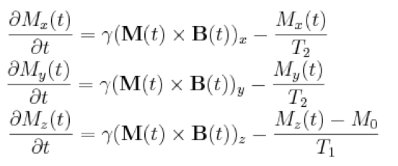
Imaging-based systems medicine
DNA
Clinical MRI
Clinical US
Protein
Clinical PET/CT
Organelle
Cell
1 GE + 2 x Siemens 3 Tesla
Tissue
Microscopy
EM
Confocal
Organ
Animal MRl
Organism
7 Tesla Bruker Pharmascan

Slide 6
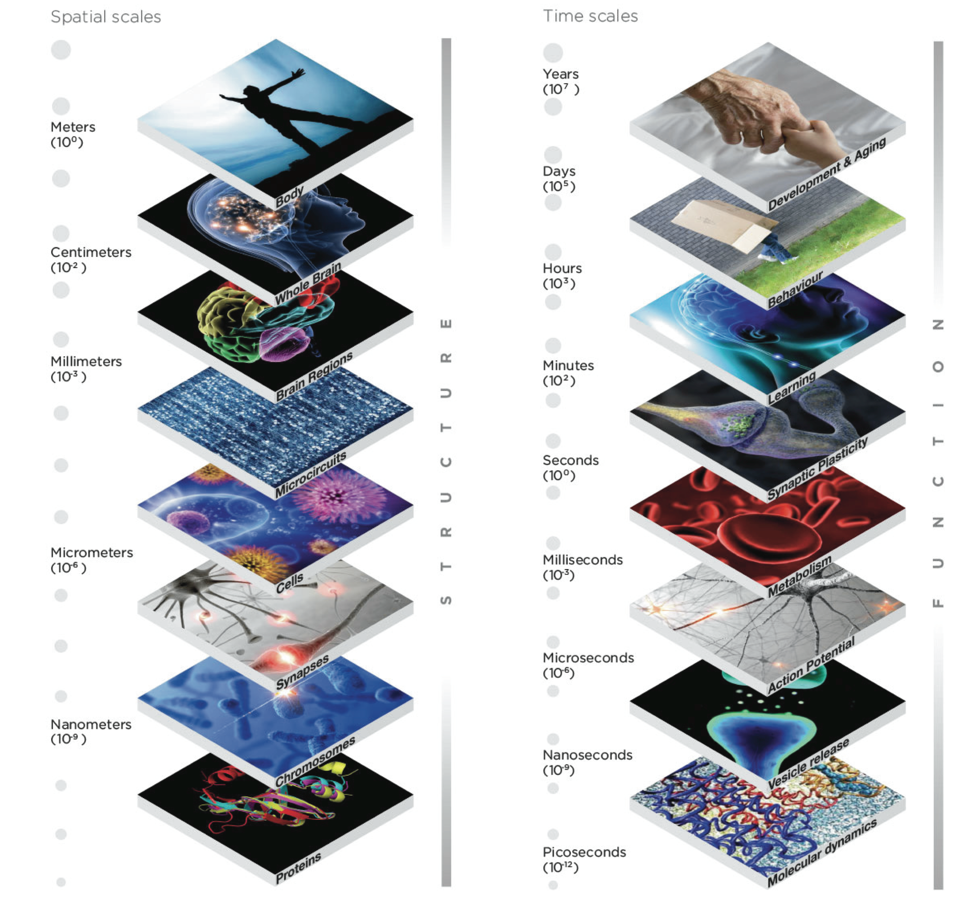
MULTISCALE
Spatial scales
Time scales
Ex:
Neurology
&
neuroscience
S T R U C T U R E
F U N C T I O N
https://www.humanbrainproject.eu

Slide 7
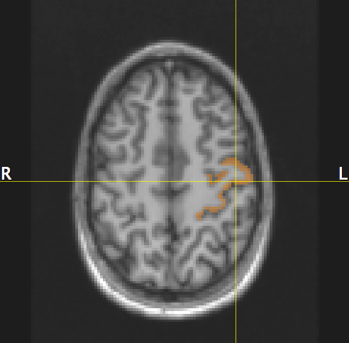
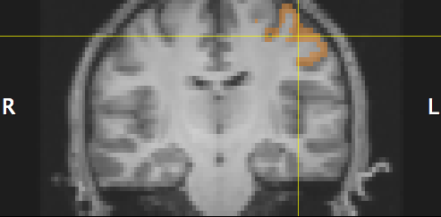
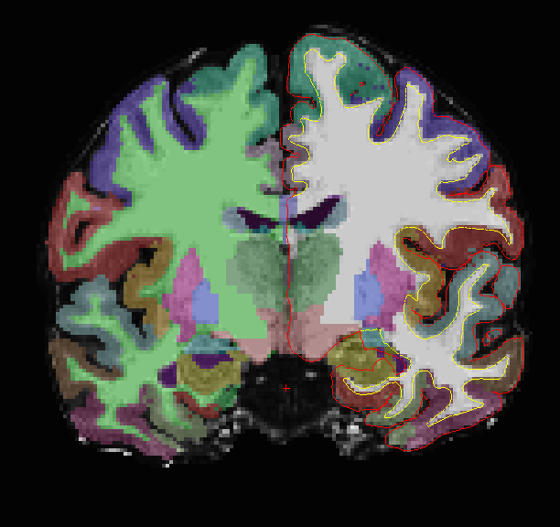
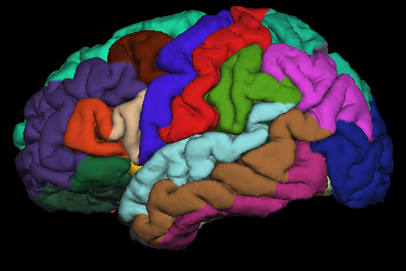
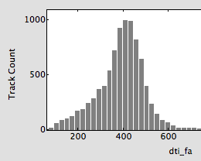
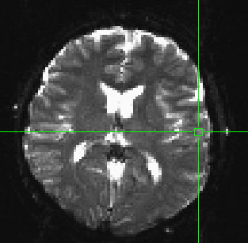
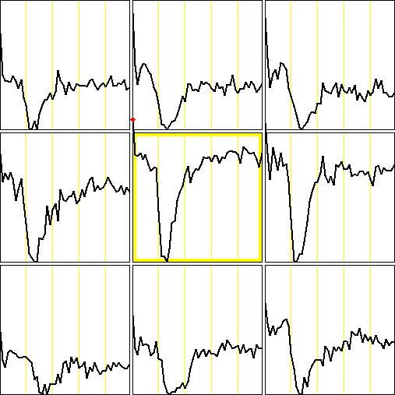
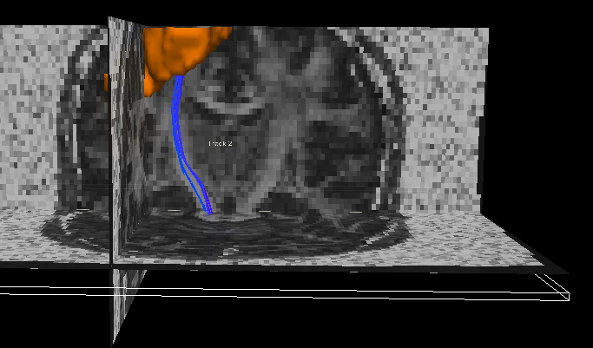
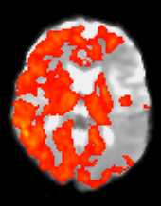
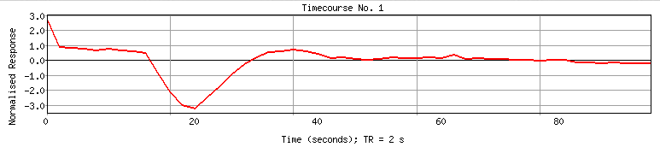
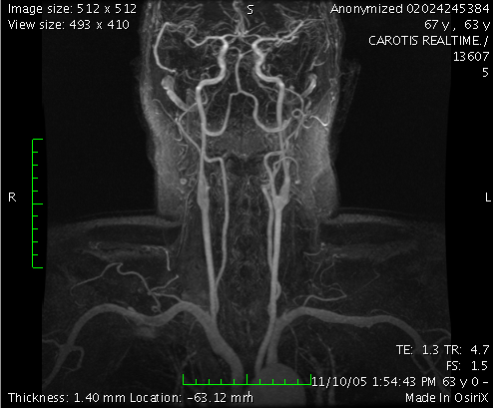
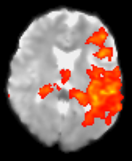
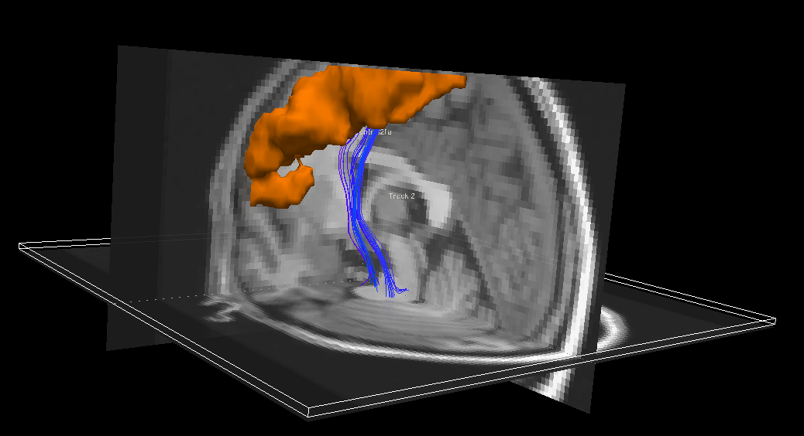
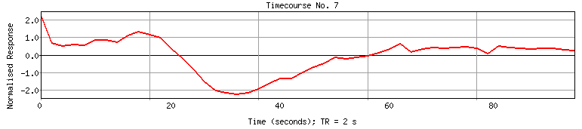
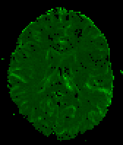
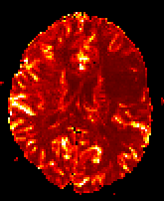
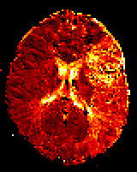
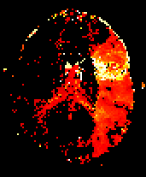
a)
3D anatomy
Left precentral gyrus
Subcortical segmentation
FA values of left
corticospinal tract
Cortical parcellation
d)
PWI
Multimodal
MR imaging
Left precentral gyrus
b)
e)
ICA analysis
DTI
c)
TOF-MRA
Ischemic region:
f)
rCBF
rCBV
rMTT
rTTP

Slide 8
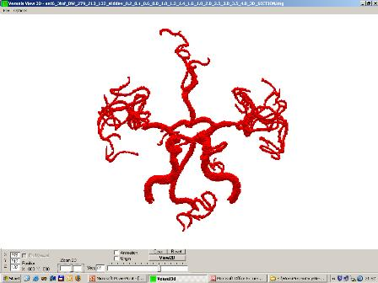
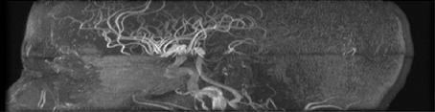
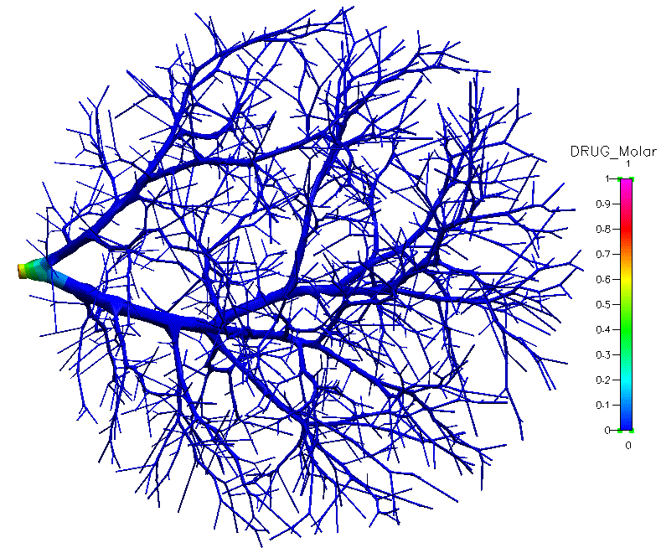
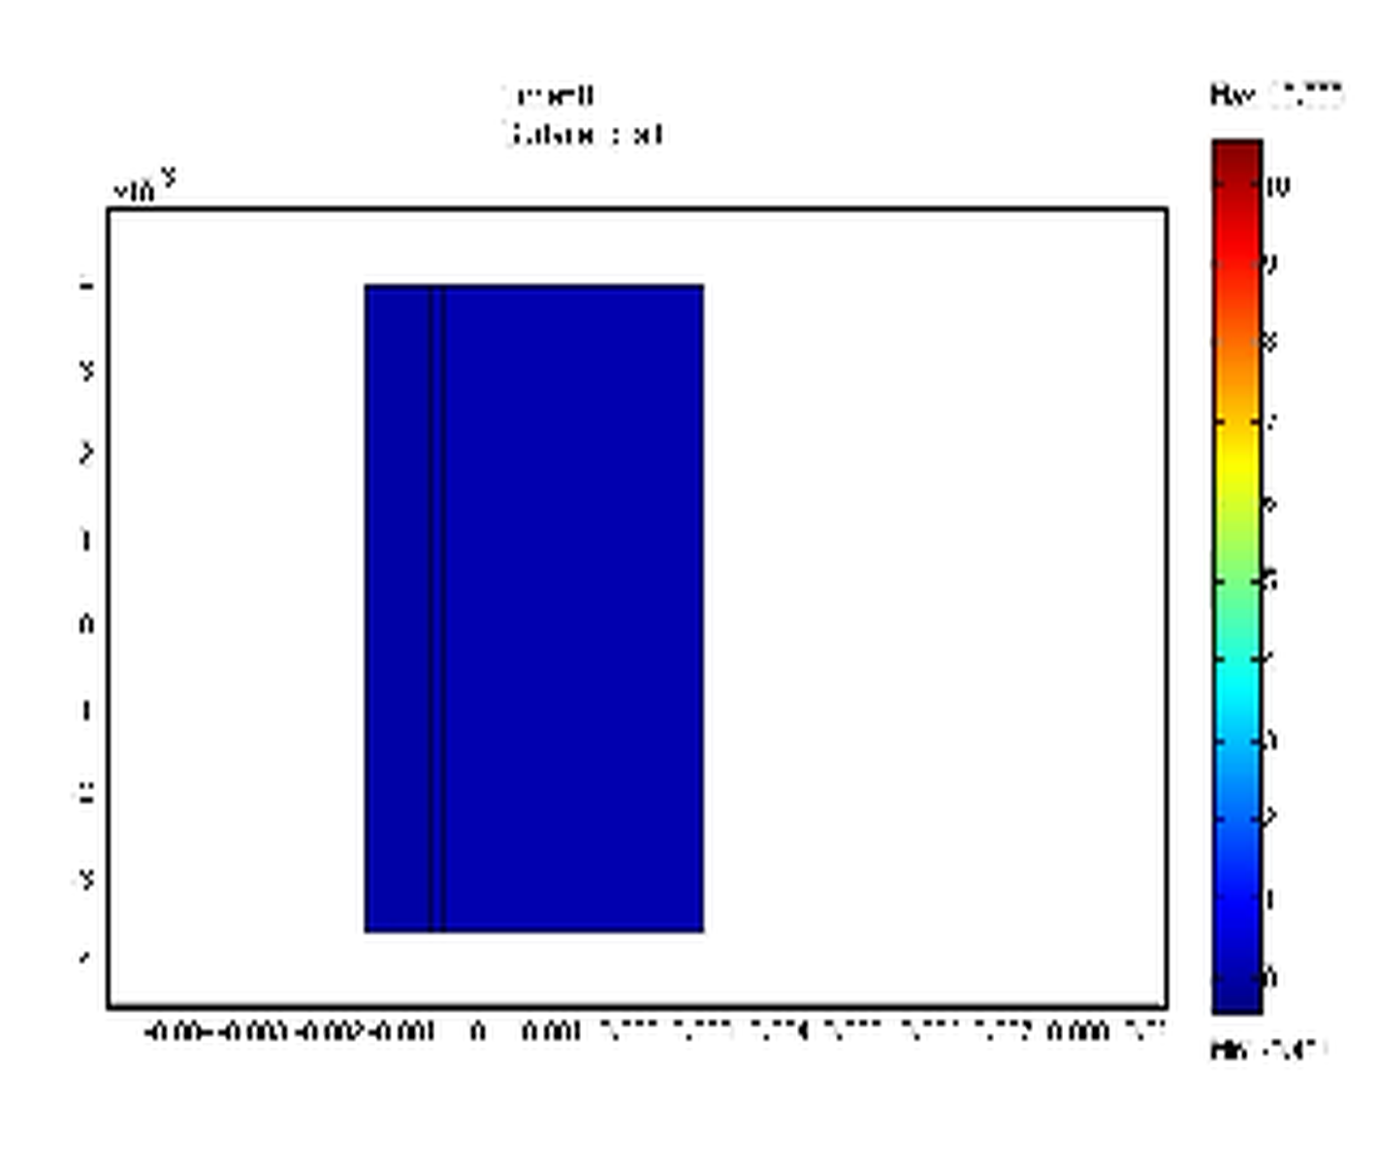
Vessels – Flow – Perfusion - Permeability
Vessel
segmentation
The 3D vascular model
3D MRI data
Modelling and simulation of drug delivery (Kocinski)
Closed tissue compartment modelling of vascular leakage assuming diffusive and convective transport
COMSOL
Multiphysics
with Marek Kocinski, Technical University of Lodz, PL
Bolus injection

Slide 9
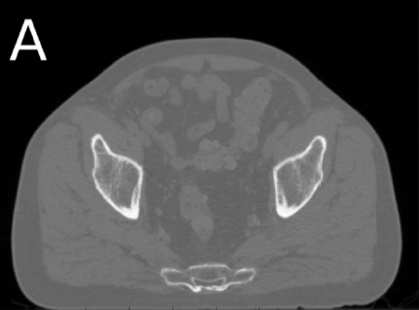
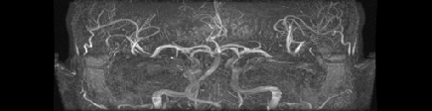
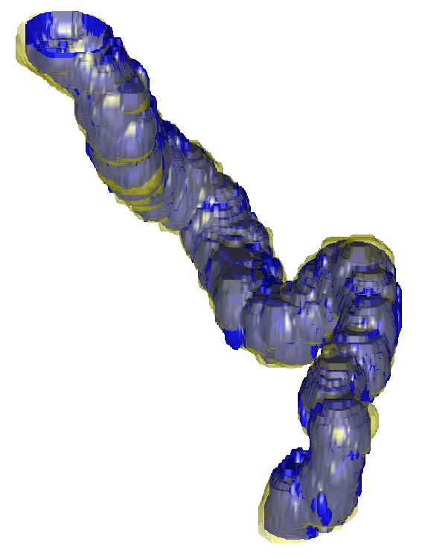
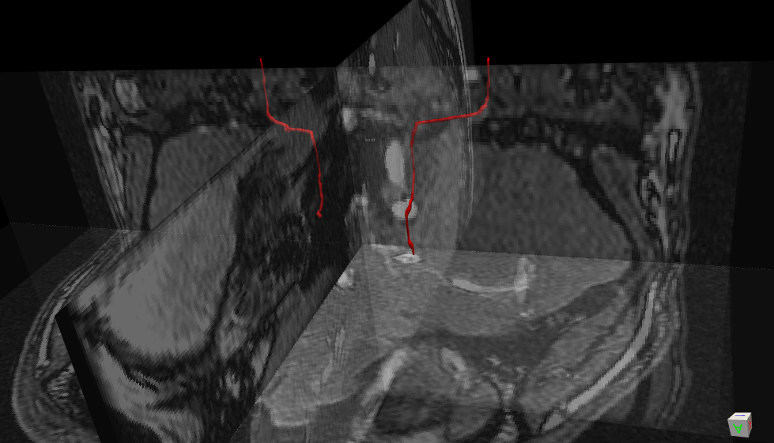
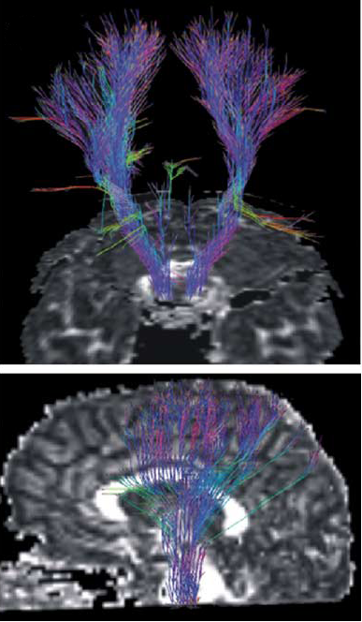
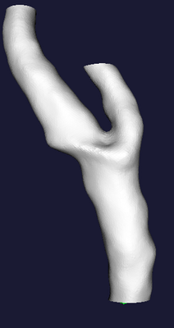
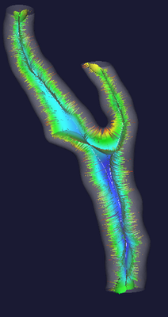
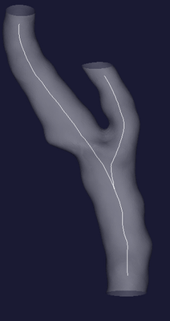

Segmenting tubular structures
Vessels (MRI)
[ Are Losnegård ]
Bowel
(CT)
Fibers (DTI)
Franaszek et al, 2006
Vascular modeling toolkit
Staempfli et al, Neuroimage 2006

Slide 10
Quantitative imaging:
“... the extraction of quantifiable features from medical images for the assessment of normal or the severity, degree of change, or status of a disease, injury, or chronic condition relative to normal.
Quantitative imaging includes the development, standardization, and optimization of anatomical, functional, and molecular imaging acquisition protocols, data analyses, display methods, and reporting structures.
These features permit the validation of accurately and precisely obtained image-derived metrics with anatomically and physiologically relevant parameters, including treatment response and outcome, and the use of such metrics in research and patient care.”
https://www.rsna.org/qiba

Slide 11
Quantitative imaging:
“... the extraction of quantifiable features from medical images for the assessment of normal or the severity, degree of change, or status of a disease, injury, or chronic condition relative to normal.
Quantitative imaging includes the development, standardization, and optimization of anatomical, functional, and molecular imaging acquisition protocols, data analyses, display methods, and reporting structures.
These features permit the validation of accurately and precisely obtained image-derived metrics with anatomically and physiologically relevant parameters, including treatment response and outcome, and the use of such metrics in research and patient care.”
https://www.rsna.org/qiba

Slide 12
Quantitative imaging:
“... the extraction of quantifiable features from medical images for the assessment of normal or the severity, degree of change, or status of a disease, injury, or chronic condition relative to normal.
Quantitative imaging includes the development, standardization, and optimization of anatomical, functional, and molecular imaging acquisition protocols, data analyses, display methods, and reporting structures.
These features permit the validation of accurately and precisely obtained image-derived metrics with anatomically and physiologically relevant parameters, including treatment response and outcome, and the use of such metrics in research and patient care.”
https://www.rsna.org/qiba

Slide 13
Biomarkers & Imaging biomarkers
Biomarker
“... a characteristic that is objectively measured and evaluated as an indicator of normal biological processes, pathogenic processes, or pharmacologic responses to a therapeutic intervention.”
( The National Institutes of Health Biomarkers Definitions Working Group )

Slide 14
Biomarkers & Imaging biomarkers
In 2007, the Radiological Society of North America (RSNA) established:
The Quantitative Imaging Biomarkers Alliance (QIBA) to “unite researchers, healthcare professionals and industry stakeholders in the advancement of quantitative imaging and the use of biomarkers in clinical trials and practice”.
Imaging biomarker
“... a biologic feature, or biomarker detectable in an image”
Three criteria of an imaging biomarker (here denoted X_{i})
• The presence of X_{i} is closely coupled or linked to the presence of the target disease
• The detection and/or quantitative measurement of X_{i} is accurate, reproducible, and
feasible over time
• The measured changes over time in X_{i} are closely coupled or linked to the success
or failure of the therapeutic effect and the true end-point sought for the medical
therapy being evaluated.

Slide 15

QIBA Mission
Improve the value and practicality of quantitative imaging biomarkers by reducing variability across devices, patients and time.
Important part of RSNA’s commitment to transforming radiology from a qualitative to a more quantitative science.
Improved patient care resulting from accelerated devel-opment and dissemination of new pharmacologic, biologic and interventional diagnosis and treatment approaches.
http://qibawiki.rsna.org/images/5/5b/QIBA_Fact_Sheet_27-May-2016.pdf

Slide 16



www.radiomics.org
Different sources of information:
Radiomics: workflow (three steps)
acquisition of high quality standardized imaging, for diagnostic or planning purposes
(the macroscopic tumor is defined on these images, either with an automated segmentation method or alternatively by an experienced radiologist or radiation oncologist)
a large number of quantitative features is extracted from the previously defined tumor region
(these features describe, amongst others, tumor image intensity, texture and shape and size of the tumor)
analysis of the acquired imaging features.
demographics
imaging
pathology
toxicity
biomarkers
genomics
proteomics
can be used for selecting the optimal treatment

Slide 17



Quantitative imaging
- texture
- texture

Slide 18


Slide 19



Farmakokinetisk modellering (GFR måling) i den bevegelige nyre
R. Sance et al., 2006
S. Lee et al. (2003) Dynamic 3D MR renography for measurement of single kidney function: initial experience.

Slide 20


Farmakokinetisk
modellering
(GFR som biomarkør)
i den bevegelige nyre

Slide 21


Quantitative imaging
- texture
Dynamic contrast enhanced MRI - motion correction
- texture

Slide 22


Multiparametrtic MRI of prostate cancer
Quantitative imaging

Slide 23

Three study waves, 3 years apart; n=131 healthy subjects (50-80 yrs) at inclusion: genetics + multimodal brain MRI + cognition
Morphometric biomarkers by automated brain segmentation: e.g. local cortical thickness

Slide 24


Brain-Gut-Microbiota interaction in IBS *
IBS = Irritable Bowel Syndrome
Functional GI disorder
Motivation / context
Mechanisms:
Emeran A. Mayer, Jennifer S. Labus, Kirsten Tillisch, et al.
Towards a systems view of IBS
Nat. Rev. Gastroenterol. Hepatol. 2015;12:592–605
Chronically recurring
abdominal pain
and discomfort
with altered
bowel habits …
Prevalence: 10-15%
Brain-Gut
axis
(ROME IV criteria)
*) Hausken, Lundervold et al. NFR FRIPRO & Helse-Vest applications

Slide 25










Experimental design
Anatomical 3DT1 SPGR DTI (6 b=0, 30 b=1000) RS-fMRI (240 volumes, TR=2 s)
Pre-intervention
scans:
(1)
Anatomical 3DT1 SPGR RS-fMRI (240 volumes, TR=2 s)
Intervention:
Post-intervention
scans:
500 ml Toro meat soup
(2)
(3)
repositioning
in scanner:
(outside magnet)
3T GE Signa Excite HD
fMRI_111005_suppe_kk

Slide 26

Cortical regions of the salience network
(FreeSurfer segmentation of the first scan of subject 1)
[1] ACC_caudal_L
[2] Middle_frontal_caudal_L
[3] Orbitofrontal_lateral_L
[4] Orbitofrontal_medial_L
[5] Middle_frontal_rostral_L
[6] Insula_L
[7] ACC_caudal_R
[8] Middle_frontal_caudal_R
[9] Orbitofrontal_lateral_R
[10] Orbitofrontal_medial_R
[11] Middle_frontal_rostral_R
[12] Insula_R

Slide 27




Group-specific feature densities
Regional mean cortical thickness [mm]
Density
[mm]
~/GitHub/ibs-brain-signature/ibs_feature_analysis.Rmd

Slide 28

Machine Learning for imaging biomarkers
The 12-7-1 feedforward multilayer neural network
Cortical
thickness:
2x30 samples (pre & post)
12 predictors
2 classes (‘HC’ and ‘IBS’)
99 synaptic weights:
1 ACC_caudal_L →
2 Middle_frontal_caudal_L →
3 Orbitofrontal_lateral_L →
4 Orbitofrontal_medial_L →
5 Middle_frontal_rostral_L →
6 Insula_L →
7 ACC_caudal_R →
8 Middle_frontal_caudal_R →
9 Orbitofrontal_lateral_R →
10 Orbitofrontal_medial_R →
11 Middle_frontal_rostral_R →
12 Insula_R →
12x7 + 7x1 + bias (= 7 + 1)
50 random samplings of
46 observations for training (75%)
(10 cross validation folds, 10 repetitions)
and
14 observations (7 HC, 7 IBS) for testing

Slide 29




Machine Learning for imaging biomarkers
Classification tree
Random Forest
2013
c = diagnosis
v = measurements
Classification forest
weak learners
Ensemble model:
t = 1, …, T
Modified from Criminisi & Shotton, Springer 2013

Slide 30
RESULTS
Average prediction performance across 50 random samplings of 46 observations for training (10 cross validation folds, 10 repetitions) and
14 observations (7 HC, 7 IBS) for testing:
Neural Network
Random Forest
Mean accuracy 0.690 (SD 0.132) 0.660 (SD 0.123)
Mean sensitivity 0.694 (SD 0.161) 0.609 (SD 0.184)
Mean specificity 0.686 (SD 0.150) 0.711 (SD 0.159)
True
IBS HC
IBS 4.86 2.20
HC 2.14 4.80
Predicted
i.e. in a sample of 700 IBS patients, 214 will be undetected by their cortical thickness patterns
in a sample of 700 HC subjects, 220 will be detected as IBS by their cortical thickness patterns
~/GitHub/ibs-brain-signature/ibs_classification.Rmd

Slide 31


TRENDS
computationalmedicine.no
UiB, IRIS, HiB

Slide 32

FREMTIDEN …
fra nano til makro
Musculo-skeletal system
Circulatory system
Respiratory system
Digestive system
Nervous system
Urinary system
Reproductive system
Endocrine system
Lymphoidal system
Organisme
Organ
Muscle tissue
Nerve tissue
Connective tissue
Epithelial tissue
Blood
Vev
Celle
”Physiomics”
Mitochondria
Nucleus
Endoplasmic reticulum
Cell membrane
Organelle
Protein
Multi-skala, multi-modal,
strukturell og funksjonell kvantitativ bildediagnostikk …
DNA

Slide 33









The future of radiology …
- mindset
- skillset
- toolset
SYSTEMS BIOLOGY , SYSTEMS MEDICINE and RADIOMICS
INTERDISCIPLINARITY and COMPUTATIONAL APPROACHES
addressing the multi-scale nature of organs and tissues in health and disease
- open science
- reproducible
research
SPACE:
Atom
10⁻¹² m
Protein
10⁻⁹ m
Cell
10⁻⁶ m
Tissue
10⁻³ m
Organ
10⁰ m
Anatomy
Organ system
& organism
Physiology
Brain
Spinal
cord
Peri-
pheral
nerves
Gene
networks
Pathway models
Stochastic models
Ordinary
Differential
Equations
Continuum models
(Partial Differential
Equations)
Systems models
TIME:
10⁻⁶ s
molecular events
(ion channel gating)
10⁻³ s
diffusion
cell signalling
10⁰ s
motility
10³ s
mitosis
10⁶ s
protein
turnover
10⁹ s
human
lifetime
From: C. Dollery and R. Kitney, Systems biology: A vision for engineering and medicine, Tech. report, The Academy of Medical Sciences and The Royal Academy of Engineering, London, UK, Feb. 2007.

Slide 34


Department of Biomedicine, UiB -> The new Visualization center

Slide 35
Takk for oppmerksomheten !
https://en.wikipedia.org/wiki/Imaging_biomarker
www.rsna.org/qiba
www.radiomics.org
http://icm.jhu.edu
www.computationalmedicine.no
https://github.com/arvidl/computational-medicine
https://github.com/arvidl/functional-kidney-imaging

Slide 36

Quantitative
imaging

Slide 37

Quantitative imaging

Slide 38

Quantitative imaging
- texture

Slide 39

Quantitative imaging
- texture

Slide 40

Quantitative imaging
- texture

Slide 41

Quantitative imaging
Quantitative imaging
- texture

Slide 42

6) Prof. Ingfrid Haldorsen

Slide 43


